Slide 1



Exhaustive Analysis of Indian Agriculture using Power BI

Slide 2

Learning Objectives
Data Exploration: Explored data using Power BI visuals like tables to understand state, district, and yearly data structure.
Major-Crops Analysis: Analyzing the trends in the cultivation of major crops, including rice, wheat, and pulses, focusing on changes in area, production, and yield.
State Analysis: Analyze state-wise crop cultivation patterns and production levels.
Seasonal Analysis: Explore seasonal patterns in crop cultivation, considering kharif and rabi seasons.
Fruits and Vegetables Analysis: Analyze the cultivation trends of fruits, vegetables, and their overall contribution to agricultural practices.
GOAL
Source :
www.freepik.com/

Slide 3
Tools and Technology used
Power BI for data visualization and interactive dashboards.
Excel for data exploration.
Story telling
Data analysis

Slide 4
Problem Statement:
This project analyzes Indian agriculture using district-wise and year-wise data. The dataset includes detailed information on crop areas, production, and yields across different districts and years. Our goal is to use Power BI for interactive visualizations that uncover trends and disparities in agricultural practices. This analysis helps stakeholders in making informed decisions for sustainable farming and resource allocation.

Slide 5
Solution:
Interactive Power BI dashboards providing insights into year-wise and district-wise agricultural patterns.
Visualizations depicting trends in major crops and their variations over time. - Reports on regional disparities, seasonal patterns, and the impact of external factors.
Recommendations for policymakers and stakeholders in the agriculture sector.

Slide 6
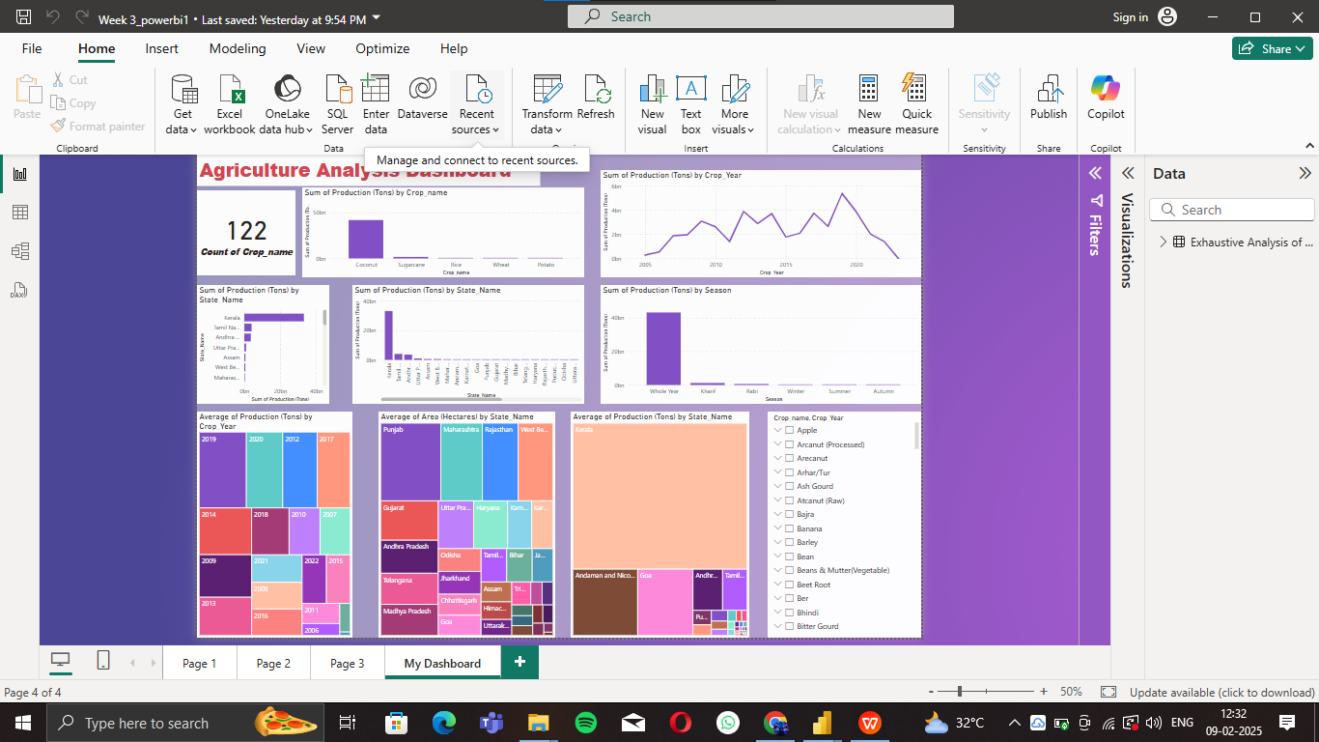
Screenshot of Output:

Slide 7
Conclusion:
This project successfully leveraged Power BI to analyze Indian agriculture data, providing valuable insights.This project provides interns with an opportunity to gain hands-on experience in agricultural data analysis and visualization using Power BI, contributing valuable insights to enhance agricultural practices and decision-making in India .patterns, production levels, and seasonal trends. The interactive dashboard and presentation enabled stakeholders
to make informed decisions to promote sustainable agriculture and optimize resource use.

